Slide 1
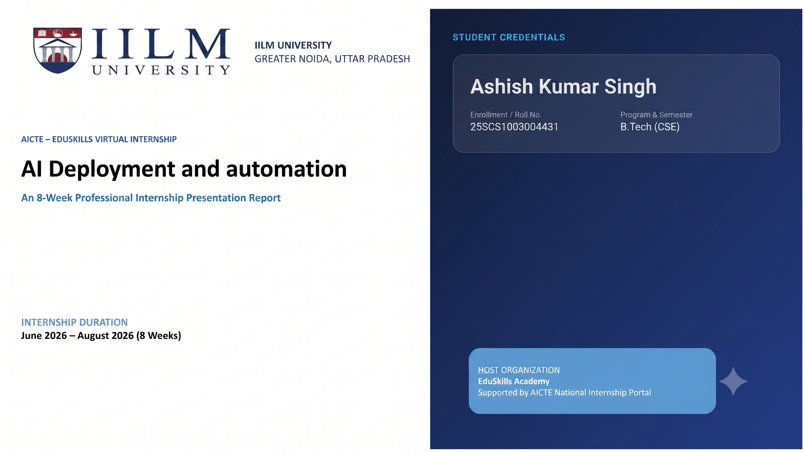

Slide 2

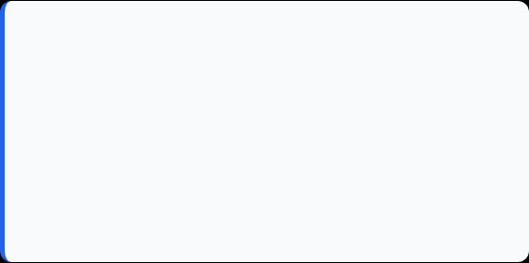
Candidate & Program Overview
Candidate Details
Internship Profile
Student Name: ASHISH KUMAR SINGH
Program Name: AICTE – EduSkills Virtual Internship
Roll Number: 25SCS1003004431
Specialization Domain: AI Deployment & Automation
Degree: B.Tech (Computer Science & Engineering)
Duration: 8 Weeks (June 2026 – August 2026)
Academic Batch: 2026-2027
Certificate ID: 2026-E38A24E157
University: IILM University, Greater Noida, U.P.
Offer Letter Ref: C17Y2026M081511743

Slide 3


Organization Profile: EduSkills Academy
EduSkills Academy is an ISO 9001:2015 and ISO 20000-1:2018 certified organization operating under the vision of "Nation Building Through Skills".
AICTE Collaboration: Operates under the patronage of the AICTE National Internship Portal to empower engineering talent across India.
Industry Alignment: Partners with leading global tech organizations to bridge academia and industry gaps in emerging tech.
Core Focus Domains: Artificial Intelligence, MLOps, Cloud Computing, Cybersecurity, and Enterprise Automation.

Slide 4

Problem Statement & Industry Context
The Industry Challenge
The Solution Scope
While academic curriculum extensively covers building Machine Learning and Deep Learning models, students often lack hands-on exposure to deploying models into real-world production systems.
This internship addresses the complete end-to-end lifecycle of production AI: model serving, container packaging, cloud hosting, automated scaling, observability, and retraining triggers.
Mastering industry-grade tools (FastAPI, Docker, Kubernetes, LangChain, SageMaker) to transform research prototypes into enterprise AI solutions.
A high-performing ML model in a Jupyter Notebook provides zero business value until it is exposed as a reliable, scalable, monitorable, and secure API service.

Slide 5








Core Project Objectives
API & Containerization
Cloud & Orchestration
Agentic Workflows & RAG
Observability & Drift
Implement continuous monitoring and logging using Prometheus, Grafana, and Evidently AI for automated drift detection.
Learn advanced model serving with FastAPI (async operations) and build portable, production-ready Docker containers for MLOps.
Deploy AI/GenAI models on Amazon SageMaker, Vertex AI, and Azure ML, and manage multi-container pods using Kubernetes.
Construct intelligent AI agents and business automation pipelines using LangChain, LlamaIndex, LangGraph, and Vector Databases.

Slide 6





Technologies & MLOps Toolchain
Serving & Apps
DevOps & Cloud
GenAI & Agents
Monitoring & Drift
Languages & APIs: Python, FastAPI (Async REST Services)
Containers: Docker, Kubernetes Cluster (Pods, Deployments)
Frameworks: LangChain, LlamaIndex, LangGraph
Observability: Prometheus, Grafana Dashboards
Serving & RAG: vLLM, Vector DBs, Quantization
Drift Analysis: Evidently AI for data drift & retraining
Frontend Integration: Streamlit, Gradio Web UI
Cloud Platforms: AWS SageMaker, Google Vertex AI, Azure ML

Slide 7
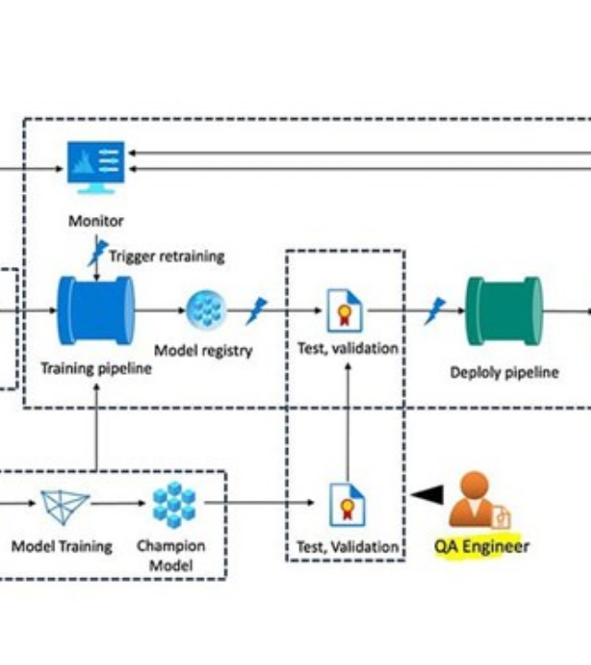
Production AI Architecture
Model Layer: Base ML / LLM models providing intelligence.
API Layer: FastAPI wrapper for sync & async inference calls.
Container & Cloud: Docker packaged containers orchestrated via Kubernetes on AWS/Azure/Vertex.
Agent & App Layer: LangChain & LlamaIndex workflows integrated with Streamlit interfaces.
Observability Layer: Real-time tracking with Prometheus, Grafana, and Evidently AI.

Slide 8
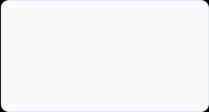
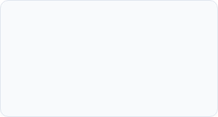
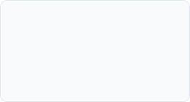
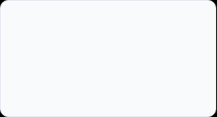
Curriculum Timeline (Weeks 1 to 4)
Week 2
Week 4
Docker & CI/CD Dockerfiles, container volumes, networking, and automated CI/CD for machine learning.
AI Agents & Automation LangChain, LlamaIndex, agent orchestration using LangGraph workflows.
Week 1
Week 3
AI Deployment & FastAPI AI lifecycle, MLOps terminology, async API endpoints, and production readiness.
Cloud AI & GenAI SageMaker, Vertex AI, Azure ML, vLLM serving, and model quantization techniques.

Slide 9
Curriculum Timeline (Weeks 5 to 8)
Week 6
Week 8
Kubernetes & Observability Container orchestration, Pods, Services, Prometheus, and Grafana logging.
Applied Capstone End-to-end full-stack RAG app deployment, business automation AI agents.
Week 5
Week 7
Security & App Integration Streamlit/Gradio apps, model security, privacy, and bias mitigation strategies.
Optimization & Drift Evidently AI drift detection, auto-retraining, Advanced RAG, and Vector DBs.

Slide 10
Key Projects & Demonstrated Skills
Production-Ready API Development: Developed high-throughput RESTful endpoints using FastAPI with async support for AI inference.
Containerization & Orchestration: Package ML models into lightweight Docker containers and orchestrating them via Kubernetes Pods & Services.
Full-Stack RAG Application: Built an end-to-end Retrieval-Augmented Generation application utilizing Vector Databases, FastAPI backend, and Streamlit frontend.
Agentic Workflows for Automation: Designed multi-step AI agents using LangChain and LangGraph for real-world enterprise business automation.
Model Governance & Drift Monitoring: Configured Evidently AI alongside Prometheus and Grafana dashboards to track prediction drift and trigger retraining.

Slide 11

Certification & Official Verification
Verification Metric | Official Record / Credential Details
Internship Title | AI Deployment & Automation Virtual Internship
Issuing Organization | EduSkills Academy (ISO 9001:2015 & ISO 20000-1:2018 Certified)
Academic Patronage | AICTE National Internship Portal & EduSkills Foundation
Certificate ID | 2026-E38A24E157 (Issued: Jul 27, 2026)
Offer Letter Ref | C17Y2026M081511743
AICTE Student ID | STU69e64f015d76a1776701185

Slide 12
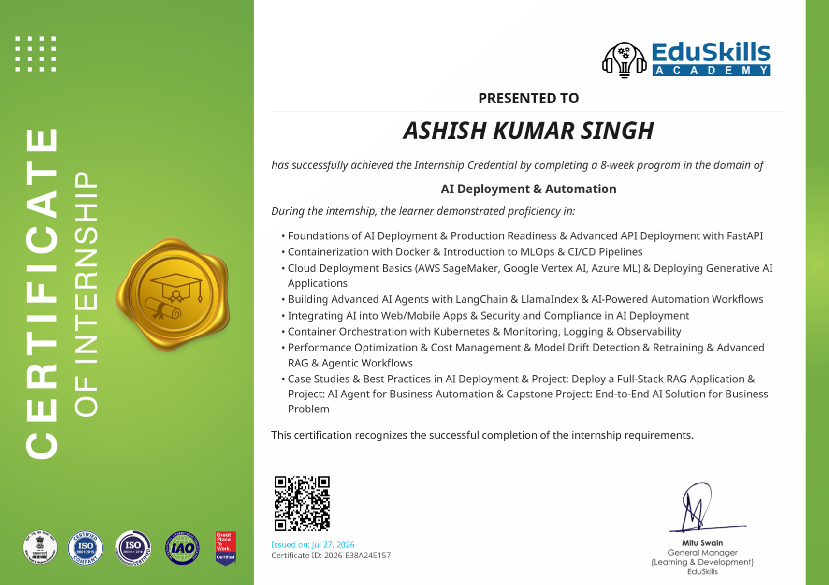
Certification & Official Verification

Slide 13
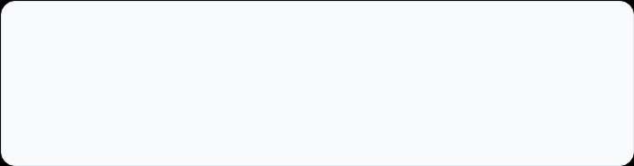
Thank You!
Ashish Kumar Singh
School of Computer Science & Engineering
Roll No: 25SCS1003004431
IILM University, Greater Noida, U.P.

